Slide 1
PATHWAYS TO RURAL RENEWAL TRANSFORMING SCHOOLS INTO COMMUNITY HUBS A Post-Pandemic ‘Schools-at-the Centre’ Strategy for Community Development
Virtual Public Talk
RURAL EDUCATION SYMPOSIUM
Guest Speaker: Paul W. Bennett, Ed.D.
Thursday February 3, 2022
SDG Counties, Cornwall, Ontario
11:00 am to 12:00 pm

Slide 2
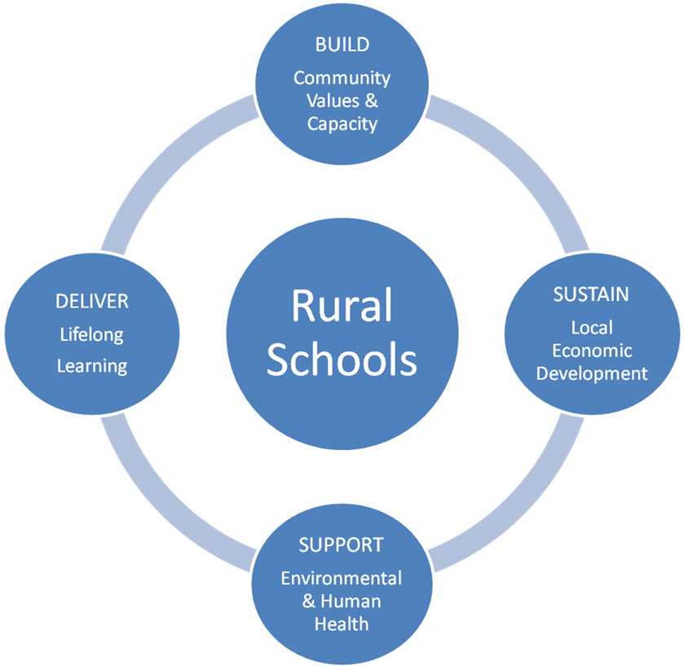
Confronting the Cycle of Decline: A Schools-at-the Centre Strategy for Rural Renewal
“In rural Canada, schools are more than just places where children and youth earn an
education. They are also the hub and lifeblood of the community. When the local school
goes, all too often so does the community.”
Beyond Freefall: Halting Rural Poverty , Final Report of the Standing Senate Committee on Agriculture and Forestry (June 2008)

Slide 3
Saving the Heartland of Rural Ontario: “Do School Closures Turn Villages into Ghost Towns?”
The village of Yarker, in the Eastern Ontario heartland, seemed to exemplify the challenges facing rural villages in Ontario. The student population of Yarker Family School had dwindled by 2016-17 to just 26 junior kindergarten to Grade 3 students and the Limestone DSB put the school under review as part of a larger plan to “optimize the utilization” rates in school buildings. It appeared to symbolize the broader trend of “villages turning into ghost towns” (CBC News Ottawa)
Yarker Rural School Protest – Limestone DSB, November 2017
The Rural Ontario Front – Yarker Family School, 2016-17

Slide 4
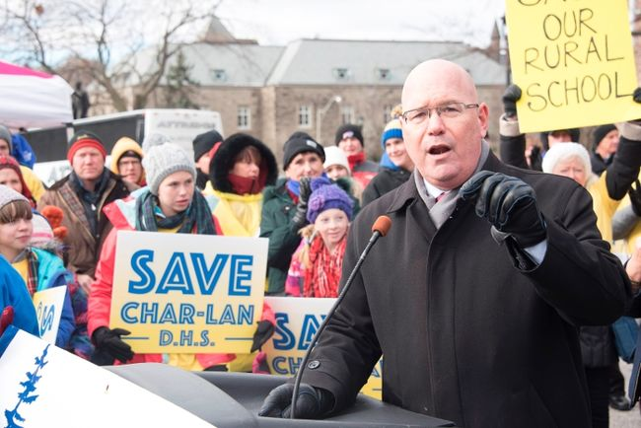
Rural Foreclosure In Ontario
Pupil Accommodation Review (PARG) Process*
A Familiar Scenario
Hundreds of small or under-enrolled schools, mostly in rural Ontario, were facing imminent closure. In September 2016, the Upper Canada District School Board (UCDSB), near the 401 Highway in Brockville, initially targeted 16 schools for review and then voted in March 2017 to close a dozen schools in small communities scattered throughout eastern Ontario.
* Ontario Ministry of Education, Guide to Pupil Accommodation Reviews (Toronto: MOE, February 2015). http://www.edu.gov.on.ca/eng/policyfunding/pupilreview.html (04/04/2017)
Sources: Ontario Alliance Against School Closures, Local Schools Matter, Facebook Group, Marcus Ryan, Curator, Zorra Township, ON https://www.facebook.com/oaasc/ (04/04/2017); and Paul W. Bennett, The State of the System: A Reality Check on Canada’s Schools. Montreal and Kingston: McGill-Queen’s University Press, 2020, p. 194.

Slide 5
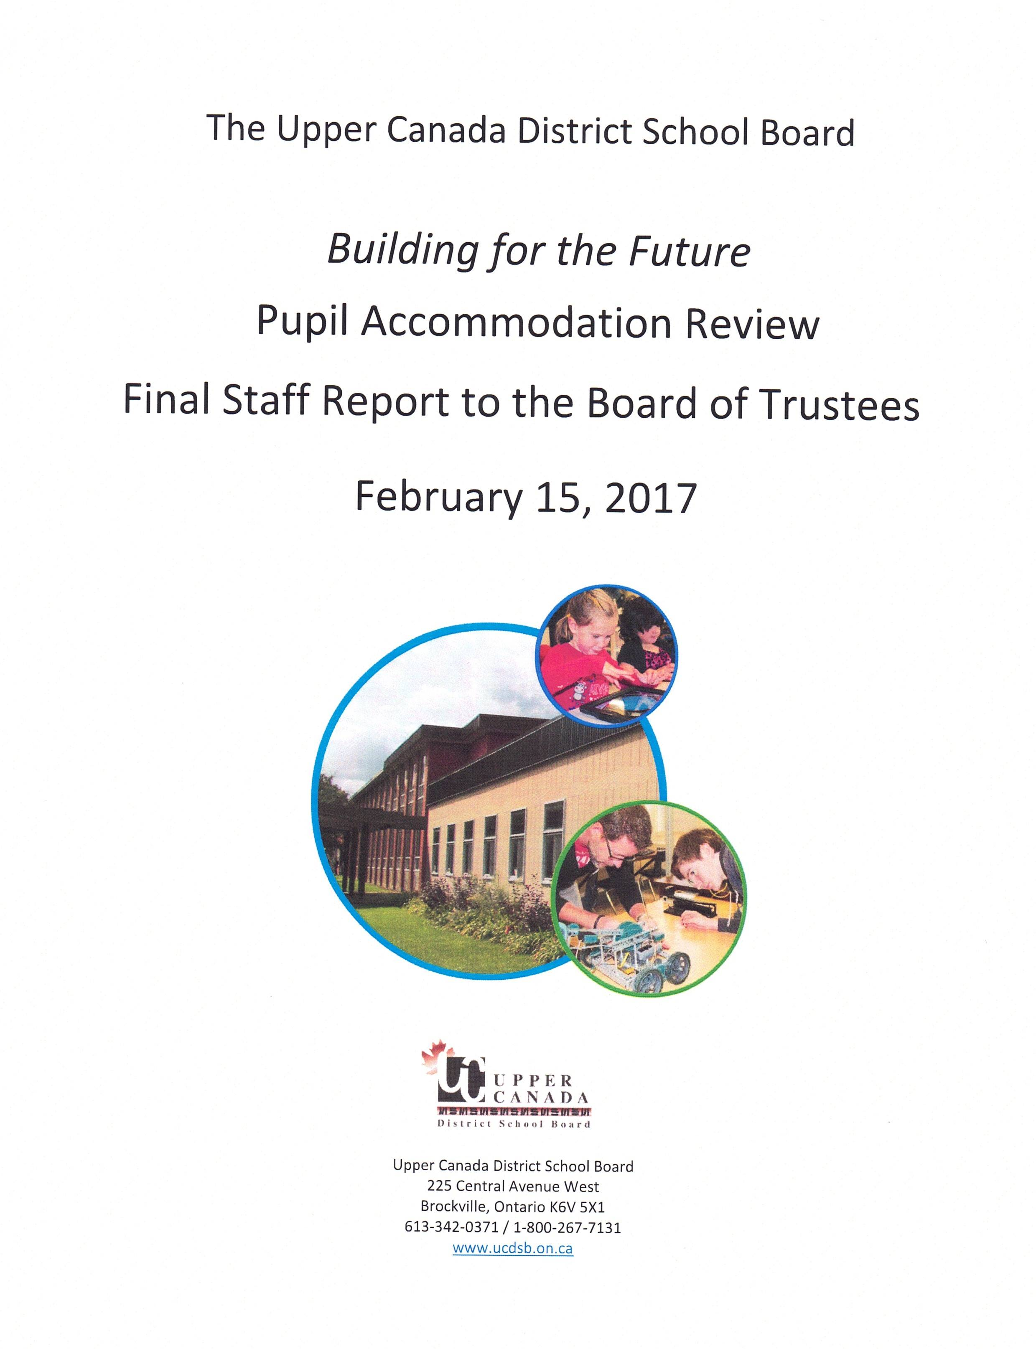
Rural Foreclosure in Ontario
Pupil Accommodation Review (PARG) Process (2015)*
The Dreaded Enabling Document
Ontario Ministry of Education, Guide to Pupil Accommodation Reviews (Toronto: MOE, February 2015). http://www.edu.gov.on.ca/eng/policyfunding/pupilreview.html (04/04/2017)

Slide 6
Rural Foreclosure in Ontario
The “Black Box” Process of School Review with Pre-Determined Outcomes
Ontario Ministry of Education, Guide to Pupil Accommodation Reviews (Toronto: MOE, February 2015). http://www.edu.gov.on.ca/eng/policyfunding/pupilreview.html (04/04/2017)

Slide 7
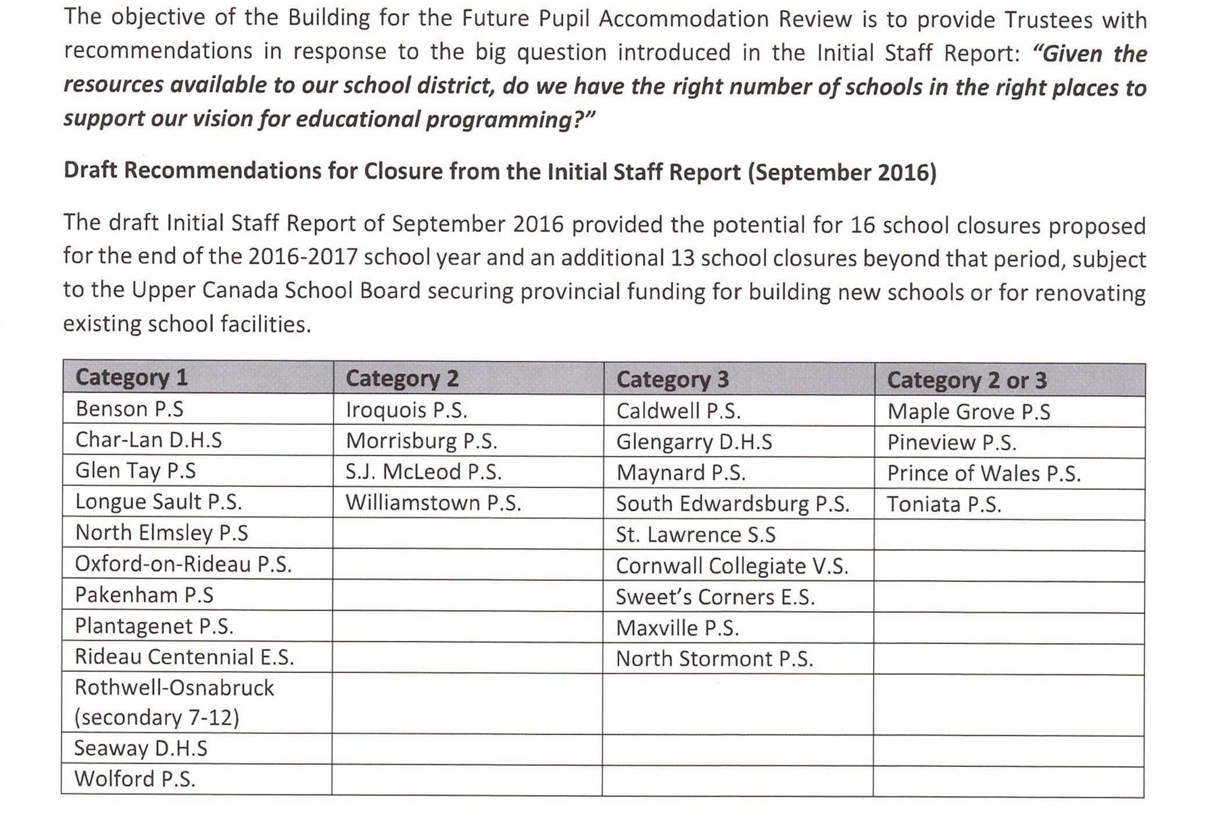
Framing of the Problem
Facing an estimated 10,000 vacant pupil places across all of the UCDSB schools, an aging inventory of school facilities, and no access to longer-term transition funding, the board simply defaulted to its usual practice. Since a February 2015 reform of the School Review policy, optimizing the use of school buildings took clear precedence over any real consideration of community interests or development possibilities.

Slide 8
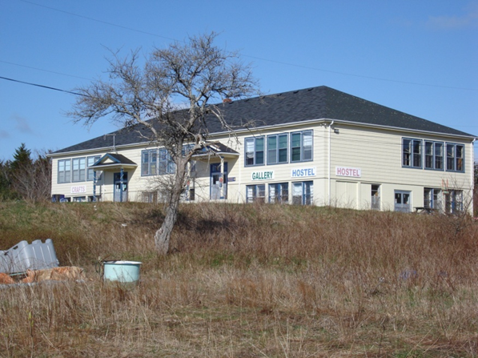
“March Madness” and School Closures

Slide 9
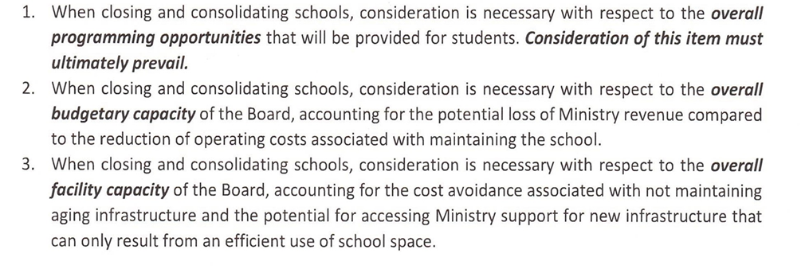
The Day of Reckoning
An even dozen schools were identified by the Upper Canada DSB and duly processed utilizing the familiar PAR process for closure (‘chopping block’ process). It’s a win-lose game which pits towns against rural villages, school against school, family against family, and even school system against school system on intensely contested educational terrain.
Lifting the Veil -- The Not-So Hidden Agenda of Consolidation
UCDSB, “Building for the Future,” Final Report to Trustees, February 15, 2017
See Elyse Skura, “12 UCDSB schools set to close following 'devastating' vote,” CBC News Ottawa, 24 March 2017;

Slide 10
* Which Way Ahead? Finding New Pathways to Community Renewal
The loss of the school can sound a death knell for a village or small town. Indeed, rural school closures have come to feel, for many, like the primary weapon in an unwritten policy to depopulate the countryside and move rural dwellers into the cities.
A government that is truly committed to enabling a thriving rural population must place rural children and their education at the forefront.
Creative partnerships with communities that are already deeply involved in their schools can ensure that healthy, vibrant rural schools can come out from under the threat of closure and take their rightful place as the centerpiece of rural revitalization.”
(Paul W. Bennett, The Last Stand 2013)
Creative local solutions are not always welcomed by school boards bent on rationalizing or off-loading underutilized facilities. Enterprising parents in the Township of South Stormont managed in the winter of 2017 to find a corporate sponsorship worth $400,000 to help save their small rural secondary school, Rothwell-Osnabruck High School. In the end, the Upper Canada District School Board voted to close the school anyway.
“Upper Canada District School Board votes to close Rothwell-Osnabruck secondary, S.J. MacLeod public schools,” Standard-Freeholder (Cornwall, ON), 23 March 2017.

Slide 11
THE SCHOOLS AT THE CENTRE VISION
Rural Schools at the Centre of Sustainable Communities
Source: Schools at the Centre: A Revitalization Strategy for Rural Communities. A Policy Brief for the Minister of Education, Province of Nova Scotia, May 15, 2012, Halifax, Nova Scotia. Graphic designed by Sandra Labor, Hubbards, NS.

Slide 12
Schools at the Centre: A Revitalization Strategy for Rural Communities A Policy Brief for the Minister of Education, Province of Nova Scotia, May 15, 2012
“We, as members of the Small Schools Delegation, representing concerned parents and activists from across Nova Scotia, call upon the Minister of Education and the Department of Education, working in collaboration with Economic and Rural Development, and other agencies, to take action to move Schools to the Centre and to address the current challenges facing Nova Scotia’s rural communities.
We recommend that the Minister of Education:
Take the lead in embracing a Rural Revitalization Strategy, working in partnership with Economic and Rural Development for an integrated government-wide approach.
Embrace our Schools at the Centre philosophy aimed at revitalizing rural education through a province-wide, community-building and development strategy.
Announce a moratorium on all School Review processes, effective June 1, 2012, affecting all schools recommended for closure in the current provincial cycle of school accommodation reviews.
Build upon the Nova Scotia Virtual School project by initiating a Rural Schools Online Education Network, based upon the Newfoundland model, creating digitally-networked schools and taking fuller advantage of distance education in the 21st century guise of virtual schooling.
Demonstrate leadership in facilitating the partnerships necessary to help small rural communities develop their school structures into multi-use community assets
Initiate an implement an open and responsive public engagement process, involving all interested groups, including school boards, regional development agencies, school councils, teachers, local boards of trade, local government and citizens.

Slide 13
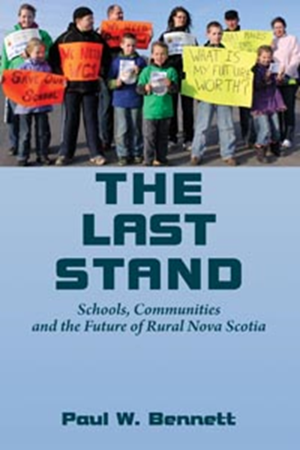
Small School Wisdom
Smaller Schools and Social Capital
“Smaller schools, like smaller towns, generate higher expectations for mutual reciprocity and collective action. So deconcentrating megaschools or creating smaller ‘schools within schools’ will almost certainly produce civic dividends.”
Robert Putnam, Bowling Alone: The Collapse and Revival of American Community (2001)
Dollars and Sense Education Planning
“Even though people may appreciate the benefits of small schools, too many think that the
cost of such schools is prohibitive. ... Measuring the cost of education by graduates rather than by all students who go through the system suggests that small schools are a wise investment.... ...small schools are not prohibitively expensive. Investing tax dollars in small schools does make sense.”
Barbara Kent Lawrence et al., Dollars & Sense: The Cost Effectiveness of Small Schools ( Cincinnati, OH: Knowledge Works Foundation, 2002), viii.

Slide 14
The Response - Mushrooming Public Support and Official Silence
Following the May 2012 presentation to the Minister, the Delegation established its own online presence as the “Nova Scotia Small Schools Initiative” on Facebook.
That Facebook site quickly became the “populist” nerve centre and clearing house for any and all reports on school closures and all types of threats to the future of rural and small town Nova Scotia.
We won a ringing endorsement in an Editorial, “New Model Schooling: The heart of a revival,`` The Chronicle Herald, 27 May 2012.

Slide 15
The 2013 School Review Suspension: A Temporary Reprieve
Declaring a provincial moratorium on the School Review process was hailed by the paper on April 4, 2013 as the right move, ending divisive exercise that had degenerated into “a dysfunctional trial” and opening the door to “a fairer more collaborative process.”
If it amounted only to a temporary cessation for electoral advantage, then the Herald editorial board saw it as a missed opportunity. “What is a step forward,” they emphasized,” is a commitment to come up with some models and criteria for the hub concept, or for other collaborative approaches to delivering education in small settings, that communities are genuinely eager to adopt.” ( Editorial, 4 April 2013).
Front Page News
The Chronicle Herald, April 3, 2013
Signs of Hope
Editorial, 4 April 2013).
News Release – Nova Scotia Education Minister Announces Halt to School Closure Process, 3 April, 2013
“The province launched a course of action today, April 3, to ensure the school-review process is fairer and better reflects the interests of students and communities.”
Minister Ramona Jennex wrote school boards to request the school-review process for 2013-14 be suspended while a new review process is being developed. She also asked the boards to delay any school closings decided in 2012-13 until the new process is in place.
Suspending the School Review process for 2013-14 provided a breathing space, but not a breakthrough for small school advocates
Declaring a provincial moratorium on the School Review process was hailed by The Chronicle Herald on April 4, 2013 as the right move, ending divisive exercise that had degenerated into “a dysfunctional trial” and opening the door to “a fairer more collaborative process.”

Slide 16
The Third Option: Community Hub Schools
The seeds of rural regeneration were beginning to sprout in the winter of 2012-13, even in the shadow of the provincially-mandated School Review process.
Three School Review Study Committees at Petite Riviere, Maitland, and River John rejected the “status quo trap,” declined to play the losing game, and generated their own community-based Third Options.
Not content to seek a reprieve, they got busy and produced incredibly innovative, community-building activities to fill the empty spaces and ensure the long-term sustainability of their schools.

Slide 17
What Would a True ‘Community Hub School’ Look Like?
“A community hub,” according to leading advocate Dr. David Clandfield, was “a central gathering place for people, their activities, and events. “
It’s more than just “a high-use multipurpose centre” and more of “a two-way hub” where “children’s learning activities within the school contribute to community development” and, in turn, “ community activities contribute to, and enrich, children’s learning within the school.” (Clandfield, 2010)

Slide 19
A Pyrrhic Victory?: The revised Nova Scotia School Review Model incorporated Hub School provision and enacted as Amendment to Education Act, 2014

Slide 20
The Community Hub School:
Where’s the Spark of Social Innovation?
One critically-important lesson –
getting Hub Schools recognized is only half the battle.
Suffocation by Regulation
Nova Scotia’s new Hub School Model regulations released in July 2014 imposed a whole new set of hurdles that made it doubly difficult to secure final approval to proceed with a conversion to Community Hub School. One School Superintendent (Gary Clarke, CCRSB) in October 2014 made that abundantly clear outlining the new rules in a talk entitled “The Operation, Opportunities and Challenges of the Community Hub Model.”
After three years of community development advocacy, the Superintendent in charge of advancing the project still didn’t seem to “get it.” Great ideas can be suffocated during implementation. More work would be required to open the school doors to the community and let social innovation in.

Slide 21
SHEREE FITCH on SMALL SCHOOLS
Maybe It Takes a Child To Raise A Village
Sheree Fitch Blog, September 3, 2013
I know the line is supposed to be "It takes a village to raise a child."
That's true. But I don't have it backwards.
For once, I'm not playing with words.
Sometimes, it takes a child to raise a village.
Children create and are the heart of any community.
I'm not a politician and I'm not a problem solver. I don't really know how politics "work."
I'm a grandmother and an educator and I write sometimes. I've even written about a small rural elementary school in a book called The Hullaballoo Bugaboo Day. It's about what happens to a school the day the school secretary disappears. Spoiler alert: the whole school falls apart. Literally. ....
But the story here is about a school that might be closed down in the village of River John. I live here.
I want the school to stay open so the heartbeat of this village continues and the children do not have to travel miles out of their community, spend hours on a school bus, when the solution is here.
Source: http://www.shereefitch.com

Slide 22
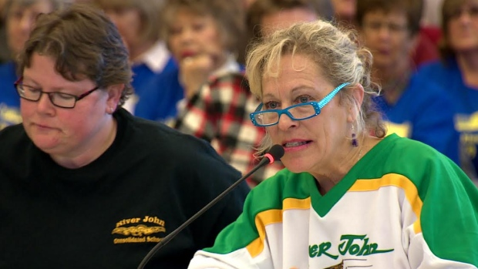
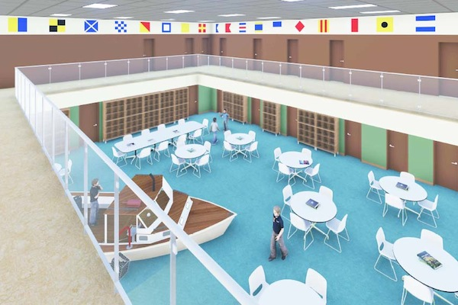
Tragedy and Rebirth: Rise and Fall of the River John Hub School Plan, 2013-15
After two years of community-wide development, the Hub Plan was rejected by the Chignecto-Central RSB in Truro in June 2015.

Slide 23
A Tiny Community Hub: Sheree Fitch’s Dreamery for Kids
Mabel Murple’s Book Shoppe and Dreamery is a seasonal book shoppe in River John on a dirt road in rural coastal Nova Scotia. We started in 2017 and now, after our third summer we are still amazed how many people come through our doors, buy books and stay for a while and picnic.
We’ve become a destination! There are donkeys and even, some say, fairies. Every season on our opening day we host Wordplay, Read By The Sea’s Children’s Book Festival. Check us out and come visit.
Contact us at www.mabelmurplesworld.ca or www.facebook.com/mabelmurples/
Join us for Wordplay/Read by the Sea: www.readbythesea.ca

Slide 24
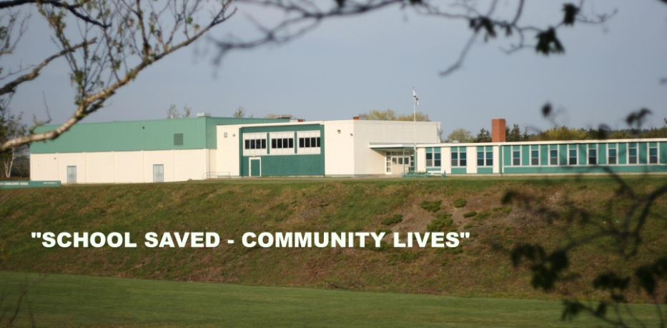
School Saved – Community Lives! A “Small Victory” in Weymouth, NS, March 2012

Slide 25
Thinking Bigger Rural Strategy Development Strategy
What does it take to initiate the process of community revitalization?
The Building Blocks -- Leadership, Vision and Priorities
No real need to completely re-invent the wheel. Provinces such as Alberta, Ontario and Nova Scotia do have broad, overarching Rural Strategies without legislative action to move them forward.
The most compelling case for school-centred community development can be found in the Social Sustainability Framework model advanced by the UK-based Young Foundation (2012)

Slide 26
What Does It Take to Build and Sustain a Vibrant Community? Proposed Social Sustainability Framework (Young Foundation, 2012)

Slide 27
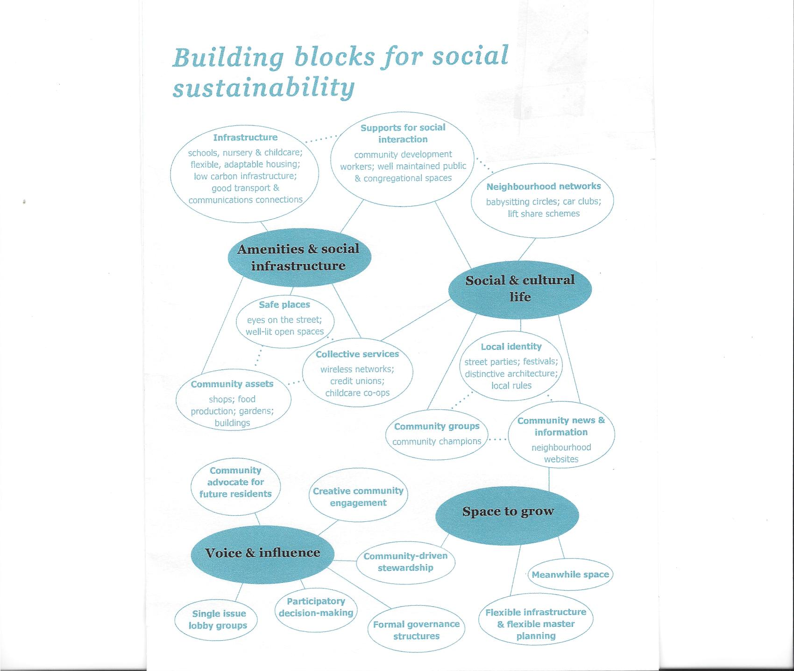

Slide 28
Curriculum Reform: Toward a Rural, Place-Based Education
Centrally-developed and managed school curricula tend to serve the demands and needs of a corporatist, managed, and networked urban society, especially in Ontario.
Yet, as Acadia University’s Michael Corbett has aptly observed, rural places will not go away. “Rustic spaces,” he points out, “continue to haunt our global consumer society and our forward-looking modernist education system.” Instead of fading from the scene, they persist and stand in the way of urban modernizers seeking to “develop” rural places as sources of resources and labour to fuel the urban, technocratic, globalized economy. Seeing themselves as essential “stewards of the land,” they instinctively resist being human fodder or “redundant labour” in a postindustrial society.
Surrounded by a world too large to be controlled, rural dwellers seek to “shrink it back to their size and reach” and “anchor themselves in places” where they can “recall their historic memories.”(Castells, 2004, 69).
In such a situation, Corbett claims that “place-based history, culture, and tradition” assume larger importance and could well form the basis for “a productive, life-sustaining infrastructure” and a local community-based curriculum that speaks to the needs and aspirations of rural children. (Corbett, AJER, 2006, 291-292).

Slide 29
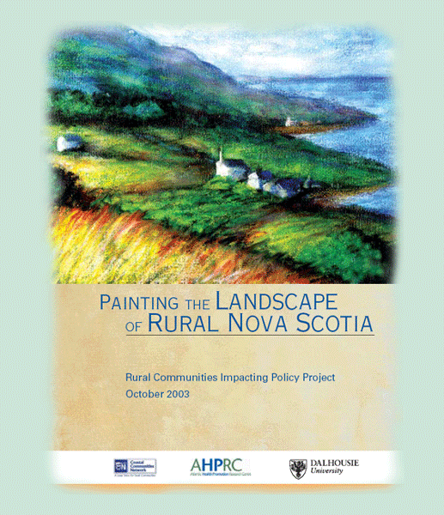
Rural Community-Based Curriculum

Slide 30
Community–Building: The Case for Public Engagement
“Successful schools are not the result of successful buildings.....it is unacceptable to move and divide our communities.”
Gerald Toney, Mi’kmaw Elder, Annapolis Valley First Nation, on the Successful Schools and Successful Students Plan, AVRSB School Board Meeting , 6 March, 2012,
A School Review process is not sufficient as a basis for charting the future shape and direction of a province’s public education system. The priorities driving such a process are those of facilities and space planning, seeking to achieve economies of scale and operational efficiencies.
The quality of education, student engagement, and strengthening school-community relations are the fundamental goals of public education, but those very goals do not factor in the current forward planning model embodied in “optimization of space utilization” and school consolidation, authorized by school accommodation reviews.
Renewing the “fleet of buildings” is the prevailing modus operandi of school districts.

Slide 31
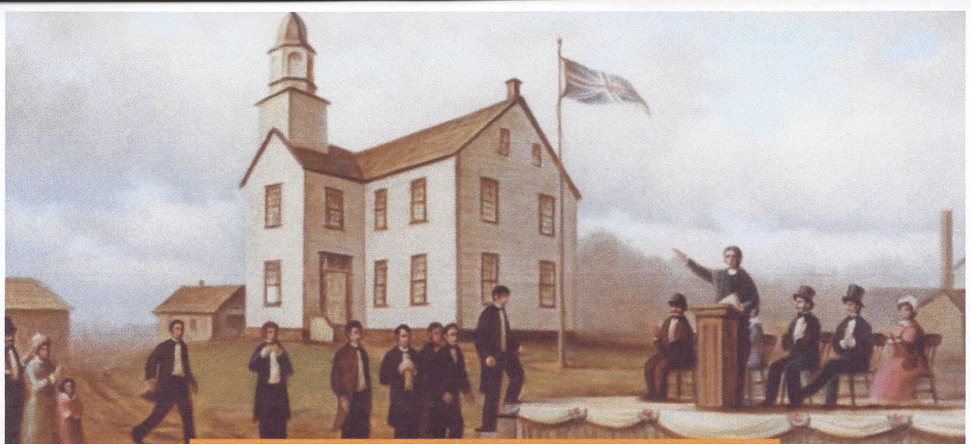
Heritage School Preservation Success: Historic Pictou Academy, Pictou, NS, 2016-17
Nova Scotia’s second oldest school, Pictou Academy (1816), was threatened with eradication in its 100th year but Mayor Jim Ryan (a former Principal) and Pictou Academy Alumni, headed by Noelle Martin, rallied to preserve the name and keep all K-12 students in their local schools.

Slide 32
Local Business Initiative Success: Chapman’s Dairy to the Rescue, April 2017 Beavercrest Public School, Markdale, Ontario
A leading Ontario dairy products company, Chapman’s Ice Cream, intervened in an attempt to save Beavercrest Public School in the company’s home town, Markdale, Ontario. The Bluewater District School Board proved ill-equipped to respond to that community-generated proposal to invest in the school’s longer-term future. Some $2 million was eventually invested by Chapman’s to repurpose a wing of the community’s school.

Slide 33
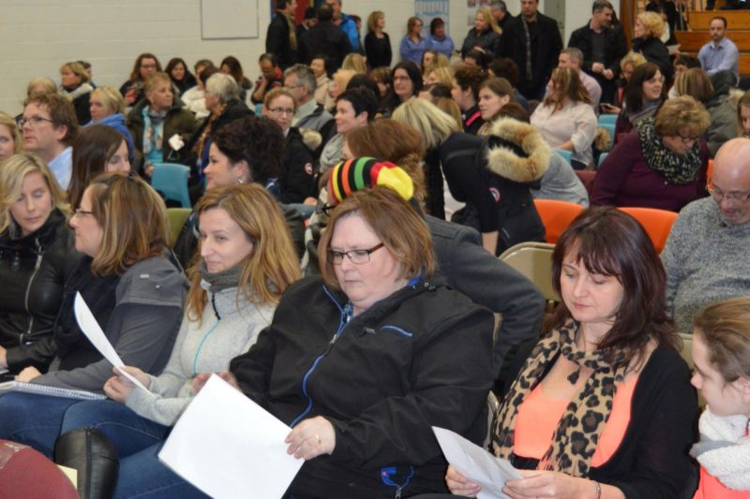
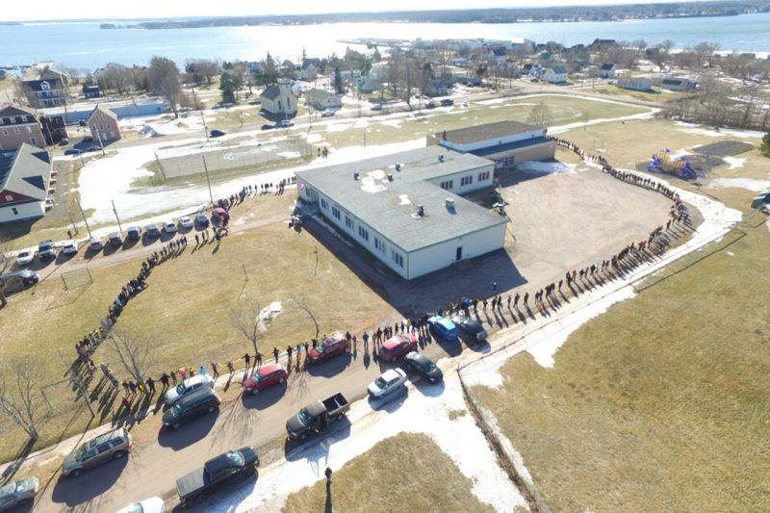
Rescuing the Village School Island Strong Movement Georgetown, Canada’s Rural Renewal Town, PEI
The Town of Georgetown, host of two major Atlantic Canadian Rural Renewal Conferences in October 2013 and June 2016, is the epicentre of Island Strong and Georgetown Elementary School survived two closure initiatives, 2009 and 2017.

Slide 34
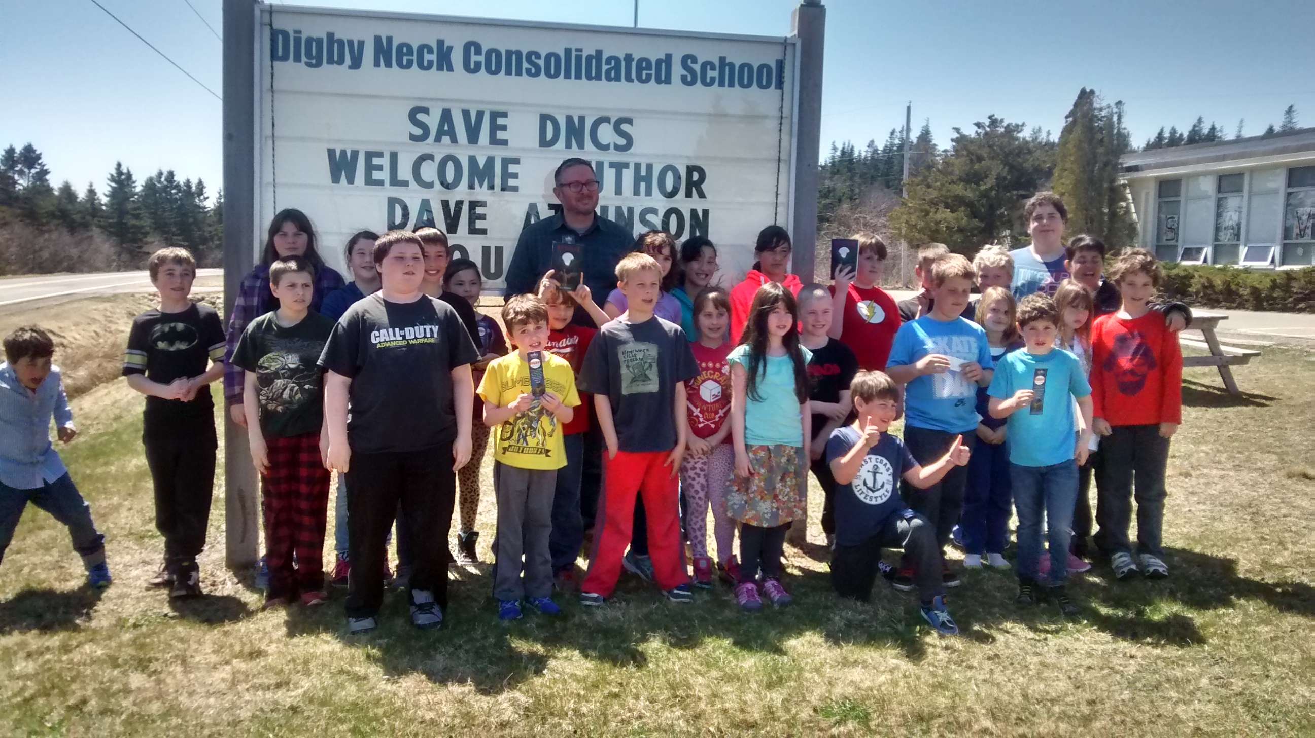
Save Our School Success: Schoolhouse Cafe Digby Neck Consolidated School, Nova Scotia
School principals can be critical in keeping small rural schools alive. One prime example was Julie Woodman’s outstanding leadership during 2015-16 in staving-off the closure of Digby Neck Consolidated School, a tiny school in rural Digby County. After blocking a Tri-County Regional School Board closure process, the parent group created a Schoolhouse Café and community meeting place on site.

Slide 35
Save Our Village School Success: Petite Riviere Community Hub Project Petite Riviere, Nova Scotia, 2013-2018
The Nova Scotia village of Petite Riviere was the point of origin for the Nova Scotia Community Hub School movement. Scheduled to close in June 2018, it was saved by a divine intervention when the province’s English school boards were abolished in February 2018.

Slide 36
“Small Victories” for Rural and Small Town Ontario Community Schools Alliance, TVDSB, November 2019
The Thames Valley District School Board is sparing two Elgin County schools once slated for closure. Families cheered as trustees voted overwhelmingly at a board meeting to rescind a previous decision to close New Sarum public school and Springfield public school. Breaking with precedent, the board backed a path recommended by local MPP and Environment Minister Jeff Yurek.
CTV News London, November 27, 2019

Slide 37
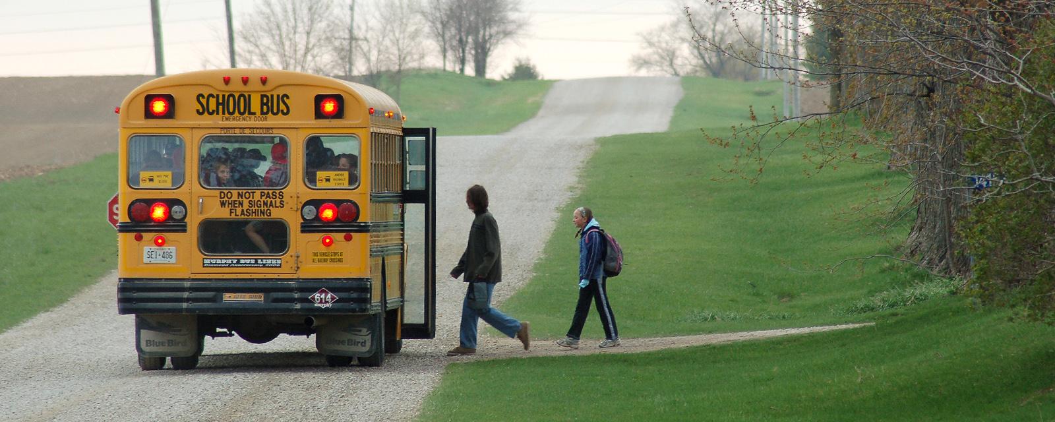
A Plan of Action Rural Education and Community Renewal
The Thames Valley School Board (TVSB) RURAL EDUCATION TASK FORCE established in June 2020 provides a model worthy of emulating elsewhere. Building upon your UNITED COUNTIES study undertaken by Monika Ferenczy and released in November 2021, all the pieces are falling into place to chart a more sustainable future.

Slide 38
Leadership, Vision and Priorities
The United Counties initiative, Rural Schools- Educating Children in Their Communities, aligns well with the guiding principles of: “Our residents are our first priority, no municipality gets left behind, partnerships as essential for our success and our environmental legacy is important.”
These principles are encompassed under a Mission “to create better communities” and a Vision “to be a progressive regional government”.
“The County is committed to working with the province, local school boards, parents and other stakeholders to develop strategies that maintain the vibrancy of our rural schools”.
Source: Monika Ferenczy, Improving Rural Education, November 21, 2021, p. 2.

Slide 39
Clarify the Overarching Objective
School-Centred Community Renewal and Development
Establish a Provincial/ Regional Education Planning (REP) Process embed it in the new Pupil Accommodation Review (PAR) Guidelines. Counter and derail the Ontario Public School Boards’ Association (OPSBA) to resurrect the 2015 PARG process suspended in 2018.
Propose and ensure that the REP process requires co-terminus boards to engage in a public and transparent process, including Third Options (i.e., alternatives to school closures such as “hubification,” sharing facilities with other school boards, community groups, creating a community hub for health, social services.
Engage regional and local municipalities in the REP process to ensure that current statistics and trends are accurate and available (e.g. subdivision plans, housing starts, growth in settlement areas)
Establish provincial enabling legislation to create joint consortia for educational services (i.e., joint ownership or management school facilities to ensure more extensive shared use by school boards, municipalities, and community groups.
Source: Monika Ferenczy, Improving Rural Education, November 21, 2021, p. 2.

Slide 40
What Does Genuine Public Engagement Look Like? Ten Key Principles (PPF/OGP)
New public expectations are emerging - to BREAK THE MOULD and be more open, transparent, accountable, and responsive.
Best decisions are local – made with active participation of those closest to those affected by decisions
Finding solutions now requires participation of all the players and builds consensus
Good policy is comprehensive – recognizes interdependence of fields (more holistic -- balancing sustainability, wellness, lifelong learning with the purely financial goals.
Taking responsibility implies having some control – give the community a much greater say in process.
Don Lenihan, Public Engagement, Public Policy Forum, 2012, pp. 122-28

Slide 41
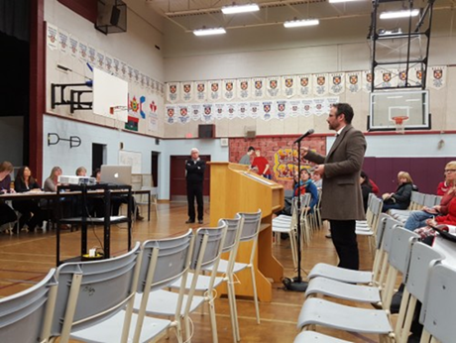
What Does Genuine Public Engagement Look Like? Ten Key Principles
6. The best decisions are made collaboratively and – it’s about collaboration, not devolution.
7. Accountability is shared -- joint decisions simply win broader public support and breeds ownership of the decisions, support for institutions and programs.
Securing and sustaining trust --success requires trust, but also builds trust, and success in one local community breeds success elsewhere.
Every community is different – treat every situation as unique, avoid systems.
10. Policy contexts are dynamic and changeable so it’s critical to link policy to practice ( i.e, shared services) and provide benchmarks for success
Dan Lenihan, Public Engagement, Public Policy Forum, 2012, pp. 122-28

Slide 42
Improving Rural Education: A School-at-the-Centre Strategy of Community Development
Set Key Priorities
Build Broad Consensus
Core Philosophy and Agenda
Preserve Schools as Vital Community Assets
Adopt a Social Sustainablity Framework
Build and Enhance School-Community Partnership Programs
Tap into Learning Technology Cooperative linkages to Small Schools
Ways and Means
Build Bridges not Walls
Seek to Unify Communities
Enhance and Strengthen Public Transparency
Model and Implement Genuine Public Engagement
Expand Rural Broadband Capacity and Facilities

Slide 43
Improving Rural Education: A School-at-the-Centre Strategy of Community Development
Establish Community-School Development (REP) Plan for Future
Seize Opportunities for Community Planning and Partnerships
Adopt a wider community development lens with a schools-at-the-centre perspective
Challenge school district orthodoxy – an excessively facilities-driven approach
View schools with declining enrolments as community assets instead of liabilities
Embrace schools-at-the centre community planning priorities, think flexibly about schools, and search for innovative solutions
Solve the excess capacity problem and in the process achieve better schools and more sustainable communities.
ONTARIO PAR Guideline, 2018
A step forward because District School Boards are required to engage in longer-range planning and to consider possible “third options,” including coterminous sharing of facilities, finding community partners to pay for the use of space, reducing the size of buildings, or sharing with co-terminus boards
All School Reviews must address the projected impacts on (1) student programing; (2) student well-being; (3) school board resources; (4) local community; (5) local economy (PARG 2018, pp. 3 and 6). Bottom Line – Better than PARG 2015 but still entrusts too much to regional boards.

Slide 44
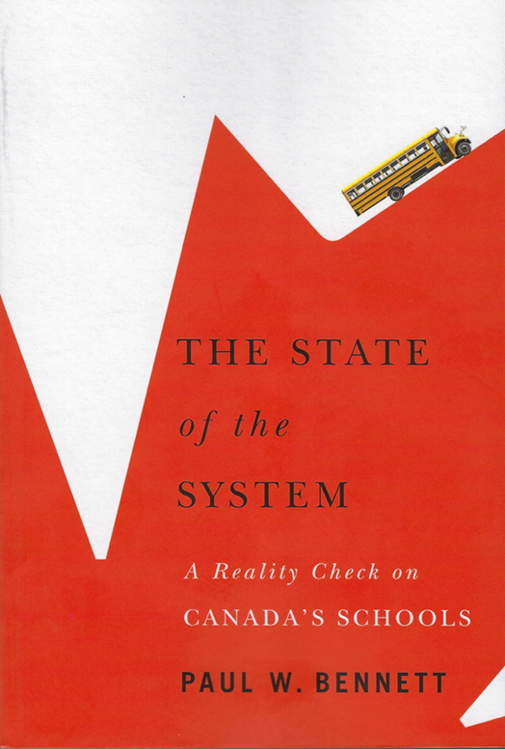
Embrace the Future: Emerging Priorities in Post-Pandemic Education
Confronting the Big Question:
What Can be Done to Turn the Tide?
Dramatic change is already underway and was triggered by natural causes – a global “Pandemic Shock”
Putting students first remains our highest priority.
Growing awareness of the critical need for meaningful public engagement, rebuilding social capital and revitalizing local communities.
The System has been shaken and is undergoing an epochal social transformation. We must not lose sight of the real challenges -- taking back our schools, preserving small schools, and “future-proofing” today’s students.
The Pandemic has awakened us to a new educational imperative – make our schools more democratic, responsive and accountable to parents, teachers, students and communities.

Slide 45
An Invitation – to Continue the Conversation
You can reach me at
Schoolhouse Consulting
www.schoolhouseconsulting.ca
Blog https://educhatter.wordpress.com/
Follow me on Twitter @Educhatter
My book, The State of the System: A Reality Check on Canada’s Schools (McGill-Queen’s University Press) is available online and at better bookstores across Canada
Schoolhouse Institute
1470 Summer Street, Suite 1006
Halifax, NS B3H 3A3
(902) 233-2414

